Slide 1
REPUBLIC OF SERBIA Ministry of Agriculture, Forestry and Water Management
MINISTRY OF FINANCE Department for Contracting and Financing of EU Funded Programmes
This project is funded by the European Union
Construction of wastewater treatment plants and (re)construction of wastewater collection networks in the cities of Brus and Blace Tender Ref. n.: NEAR/BEG/2021/EA-OP/0131NG Date/Time: 17 September 2021, 12:00h CET SITE VISIT

Slide 2
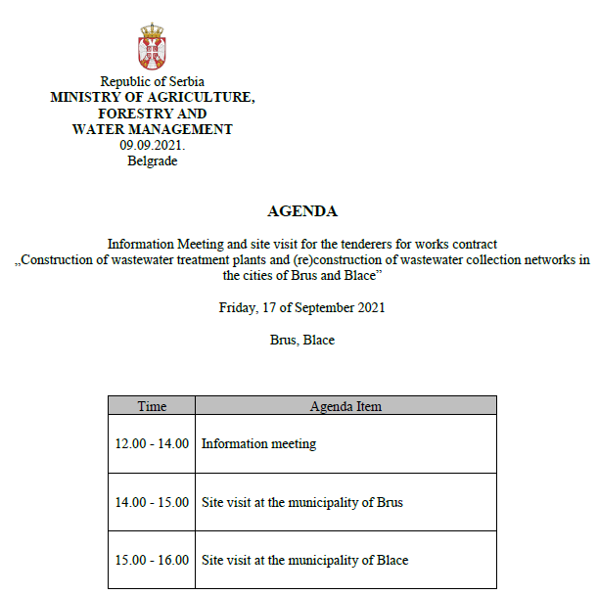
REPUBLIC OF SERBIA Ministry of Agriculture, Forestry and Water Management
MINISTRY OF FINANCE Department for Contracting and Financing of EU Funded Programmes
This project is funded by the European Union

Slide 3
REPUBLIC OF SERBIA Ministry of Agriculture, Forestry and Water Management
MINISTRY OF FINANCE Department for Contracting and Financing of EU Funded Programmes
This project is funded by the European Union
PROCEDURAL DETAILS The Project is funded by European Union through the Annual Action Programme for Serbia for the year 2017 Co-financing is provided by the Republic of Serbia The tender procedure: International open tender Procurement rules: PRAG (Practical Guide), published on 1st August 2020 Contracting Authority: The Government of the Republic of Serbia, represented by the Ministry of Finance, Department for Contracting and Financing of EU Funded Programmes (CFCU) Final Beneficiary: Ministry of Agriculture, Forestry and Water Management

Slide 4
REPUBLIC OF SERBIA Ministry of Agriculture, Forestry and Water Management
MINISTRY OF FINANCE Department for Contracting and Financing of EU Funded Programmes
This project is funded by the European Union
PROCEDURAL DETAILS
PARTIES IN PROJECT IMPLEMENTATION
CONTRACTING AUTHORITY
(CFCU)
Final Beneficiary
SUPERVISOR / ENGINEER
End Recipient
WORKS CONTRACTOR

Slide 5
REPUBLIC OF SERBIA Ministry of Agriculture, Forestry and Water Management
MINISTRY OF FINANCE Department for Contracting and Financing of EU Funded Programmes
This project is funded by the European Union
PROCEDURAL DETAILS Any questions related to the technical and legal aspect of the tender dossier must be submitted in writing through the TED eTendering website, in accordance with the instructions provided in the tender dossier Contracting Authority shall publish official answers at the addresses indicated in the tender dossier and in line with the deadlines defined in the tender documentation Only these answers shall be considered official answers of the Contracting Authority Please note that participation at the tender opening session is restricted to authorised representatives of the companies that are tendering for the contract. Each representative will have to submit the document of authorisation. Each company attending the meeting and site visit need to receive CERTIFICATE OF ATTENDANCE All tenders must include this Certificate In the case of a consortium it is sufficient that at least one member of the consortium has participated to the site visit and the corresponding attendance certificate is included in the offer.

Slide 6
REPUBLIC OF SERBIA Ministry of Agriculture, Forestry and Water Management
MINISTRY OF FINANCE Department for Contracting and Financing of EU Funded Programmes
This project is funded by the European Union
PROCEDURAL DETAILS
INSTRUCTIONS TO TENDERERS,
Section 1.2 TIMETABLE

Slide 7
REPUBLIC OF SERBIA Ministry of Agriculture, Forestry and Water Management
MINISTRY OF FINANCE Department for Contracting and Financing of EU Funded Programmes
This project is funded by the European Union
Thank you for your attention

