Slide 1
REPUBLIC OF SERBIA MINISTRY OF ENVIRONMENTAL PROTECTION MINISTRY OF FINANCE Department for Contracting and Financing of EU Funded Programmes
This project is funded by the European Union
Construction and Upgrading of Municipal Wastewater Collection and Treatment system in Kraljevo Tender Ref. n.: NEAR/BEG/2021/EA-OP/0098ING Date/Time: 15 September 2021, 11:00h CET INFORMATION MEETING

Slide 2
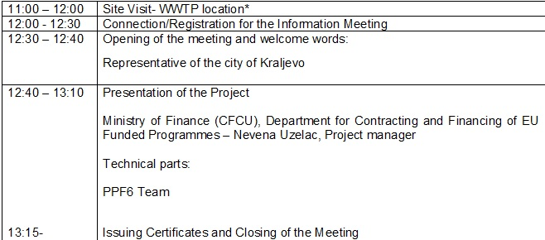
REPUBLIC OF SERBIA MINISTRY OF ENVIRONMENTAL PROTECTION MINISTRY OF FINANCE Department for Contracting and Financing of EU Funded Programmes
This project is funded by the European Union
AGENDA

Slide 3
REPUBLIC OF SERBIA MINISTRY OF ENVIRONMENTAL PROTECTION MINISTRY OF FINANCE Department for Contracting and Financing of EU Funded Programmes
This project is funded by the European Union
MAIN OBJECTIVES OF THE PROJECT The main objective of this project is to construct a new WWTP in order to protect the River Ibar and the River Zapadna Morava and the affected groundwaters from pollution discharged by untreated wastewater and to ensure full compliance with the relevant national and European legislation.

Slide 4
REPUBLIC OF SERBIA MINISTRY OF ENVIRONMENTAL PROTECTION MINISTRY OF FINANCE Department for Contracting and Financing of EU Funded Programmes
This project is funded by the European Union
PROCEDURAL DETAILS The Project is funded by European Union through the Annual Action Programme for Serbia for the year 2017 Co-financing is provided by the Republic of Serbia The tender procedure: International open tender Procurement rules: PRAG (Practical Guide), published on 1st August 2020 The Works are governed by the Lot 1- FIDIC, Yellow Book, 1999; Lot 2- FIDIC, Red Book, 1999 Contracting Authority: The Government of The Republic of Serbia, represented by the Ministry of Finance, Department for Contracting and Financing of EU Funded Programmes (CFCU) Final Beneficiary: Ministry of Environmental Protection

Slide 5
REPUBLIC OF SERBIA MINISTRY OF ENVIRONMENTAL PROTECTION MINISTRY OF FINANCE Department for Contracting and Financing of EU Funded Programmes
This project is funded by the European Union
PROCEDURAL DETAILS Any questions related to the technical and legal aspect of the tender dossier must be submitted in writing through the TED eTendering website, in accordance with the instructions provided in the tender dossier Contracting Authority shall publish official answers at the addresses indicated in the tender dossier and in line with the deadlines defined in the tender documentation Bear in mind only these answers shall be considered official answers of the Contracting Authority

Slide 6
REPUBLIC OF SERBIA MINISTRY OF ENVIRONMENTAL PROTECTION MINISTRY OF FINANCE Department for Contracting and Financing of EU Funded Programmes
This project is funded by the European Union
PROCEDURAL DETAILS Each company attending the meeting and site visit need to receive CERTIFICATE OF ATTENDANCE All tenders must include this Certificate in their offer. In the case of a consortium it is sufficient that at least one member of the consortium has participated to the site visit Please note that participation at the tender opening session is restricted to authorised representatives of the companies that are tendering for the contract.

Slide 7
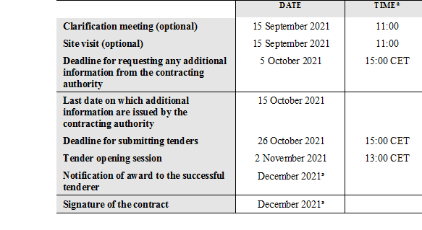
REPUBLIC OF SERBIA MINISTRY OF ENVIRONMENTAL PROTECTION MINISTRY OF FINANCE Department for Contracting and Financing of EU Funded Programmes
This project is funded by the European Union
PROCEDURAL DETAILS
INSTRUCTIONS TO TENDERERS,
Section 1.2 TIMETABLE

Slide 8
REPUBLIC OF SERBIA MINISTRY OF ENVIRONMENTAL PROTECTION MINISTRY OF FINANCE Department for Contracting and Financing of EU Funded Programmes
This project is funded by the European Union
Thank you for your attention

