Slide 1
REPUBLIC OF SERBIA MINISTRY OF MINING AND ENERGY PE SRBIJAGAS MINISTRY OF FINANCE Department for Contracting and Financing of EU Funded Programmes
This project is funded by the European Union
Construction of Gas Interconnector Serbia-Bulgaria on the Serbian territory Tender Ref. n.: NEAR/BEG/2021/EA-OP/0032ING Date/Time: 26 April 2021, 11:00h CET ONLINE INFORMATION MEETING

Slide 2
REPUBLIC OF SERBIA MINISTRY OF MINING AND ENERGY PE SRBIJAGAS MINISTRY OF FINANCE Department for Contracting and Financing of EU Funded Programmes
This project is funded by the European Union
AGENDA

Slide 3
REPUBLIC OF SERBIA MINISTRY OF MINING AND ENERGY PE SRBIJAGAS MINISTRY OF FINANCE Department for Contracting and Financing of EU Funded Programmes
This project is funded by the European Union
PROCEDURAL DETAILS The Project is funded by European Union through the Annual Action Programme for Serbia for the year 2017 Co-financing is provided by the Republic of Serbia The tender procedure: International open tender Procurement rules: PRAG (Practical Guide), published on 1st August 2020 The Works are governed by the "CONDITIONS OF CONTRACT FOR CONSTRUCTION for Building and Engineering Works Designed by Employer" - General Conditions, first edition 1999 (ISBN 2-88432-022-9), published by the Fédération Internationale des Ingénieurs–Conseils (FIDIC), and the “Particular Conditions” which include amendments and additions to such General Conditions. Contracting Authority: The Government of the Republic of Serbia, represented by the Ministry of Finance, Department for Contracting and Financing of EU Funded Programmes (CFCU) Final Beneficiary: Ministry of Mining and Energy of the Republic of Serbia End Recipient: Public Enterprise “Srbijagas”

Slide 4
REPUBLIC OF SERBIA MINISTRY OF MINING AND ENERGY PE SRBIJAGAS MINISTRY OF FINANCE Department for Contracting and Financing of EU Funded Programmes
This project is funded by the European Union
PROCEDURAL DETAILS
PARTIES IN PROJECT IMPLEMENTATION
CONTRACTING AUTHORITY
(CFCU)
MINISTRY OF MINING AND ENERGY / Final Beneficiary
SUPERVISOR / ENGINEER
PE SRBIJAGAS / End Recipient
WORKS CONTRACTOR

Slide 5
REPUBLIC OF SERBIA MINISTRY OF MINING AND ENERGY PE SRBIJAGAS MINISTRY OF FINANCE Department for Contracting and Financing of EU Funded Programmes
This project is funded by the European Union
PROCEDURAL DETAILS Any questions related to the technical and legal aspect of the tender dossier must be submitted in writing through the TED eTendering website, in accordance with the instructions provided in the tender dossier Contracting Authority shall publish official answers at the addresses indicated in the tender dossier and in line with the deadlines defined in the tender documentation Only these answers shall be considered official answers of the Contracting Authority Please note that participation at the tender opening session is restricted to authorised representatives of the companies that are tendering for the contract. Each representative will have to submit the document of authorisation.

Slide 6
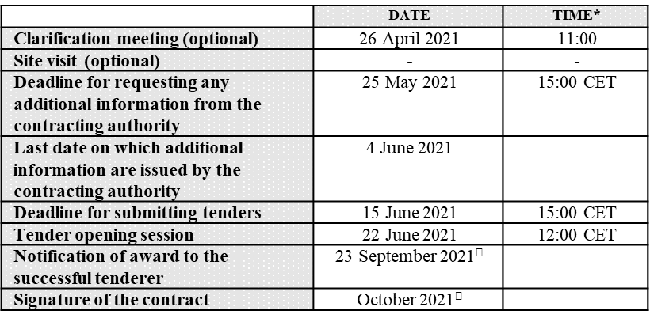
REPUBLIC OF SERBIA MINISTRY OF MINING AND ENERGY PE SRBIJAGAS MINISTRY OF FINANCE Department for Contracting and Financing of EU Funded Programmes
This project is funded by the European Union
PROCEDURAL DETAILS
INSTRUCTIONS TO TENDERERS,
Section 1.2 TIMETABLE

Slide 7
REPUBLIC OF SERBIA MINISTRY OF MINING AND ENERGY PE SRBIJAGAS MINISTRY OF FINANCE Department for Contracting and Financing of EU Funded Programmes
This project is funded by the European Union
PROJECT IMPORTANCE Realization of this project provides diversification of routes and sources of supply, with the improvement of security of supply of Serbia, Bulgaria and the entire region. IBS project is in full compliance with the aim of the integrated regional energy market establishment, in accordance with the principles of EU regulations and the very concept of the EU Energy Union. The main advantages that the Serbia-Bulgaria gas interconnection project should provide for Serbia, Bulgaria and the region are as follows: Direction Bulgaria - Serbia: - construction of an alternative direction of natural gas supply to the Republic of Serbia (diversification - security of supply) - creation of energy potential for the realization of more intensive gasification of eastern and southern Serbia (at least 200,000 households) - creation of energy potential for the realization of interconnection and gas supply of North Macedonia, Kosovo and Montenegro.

Slide 8
REPUBLIC OF SERBIA MINISTRY OF MINING AND ENERGY PE SRBIJAGAS MINISTRY OF FINANCE Department for Contracting and Financing of EU Funded Programmes
This project is funded by the European Union
- complementary with completion of the construction of the Greece-Bulgaria interconnection, the possibility of supplying Serbia with natural gas from the LNG terminal Revitousa and the planned Alexandropoulos, as well as natural gas from the TAP gas pipeline. - construction of the Turkey - Bulgaria interconnection, gas supply from the future TANAP system (gas from the Caspian region, Iran, etc.) Direction Serbia - Bulgaria: - opening of significant potential for delivery of natural gas from current and future storage facilities of Serbia (Banatski dvor, Itebej) to both Bulgaria and Greece. - Possibility of transit delivery of natural gas to Bulgaria or Greece from the direction of Austria or Hungary (North to South Scenario).

Slide 9
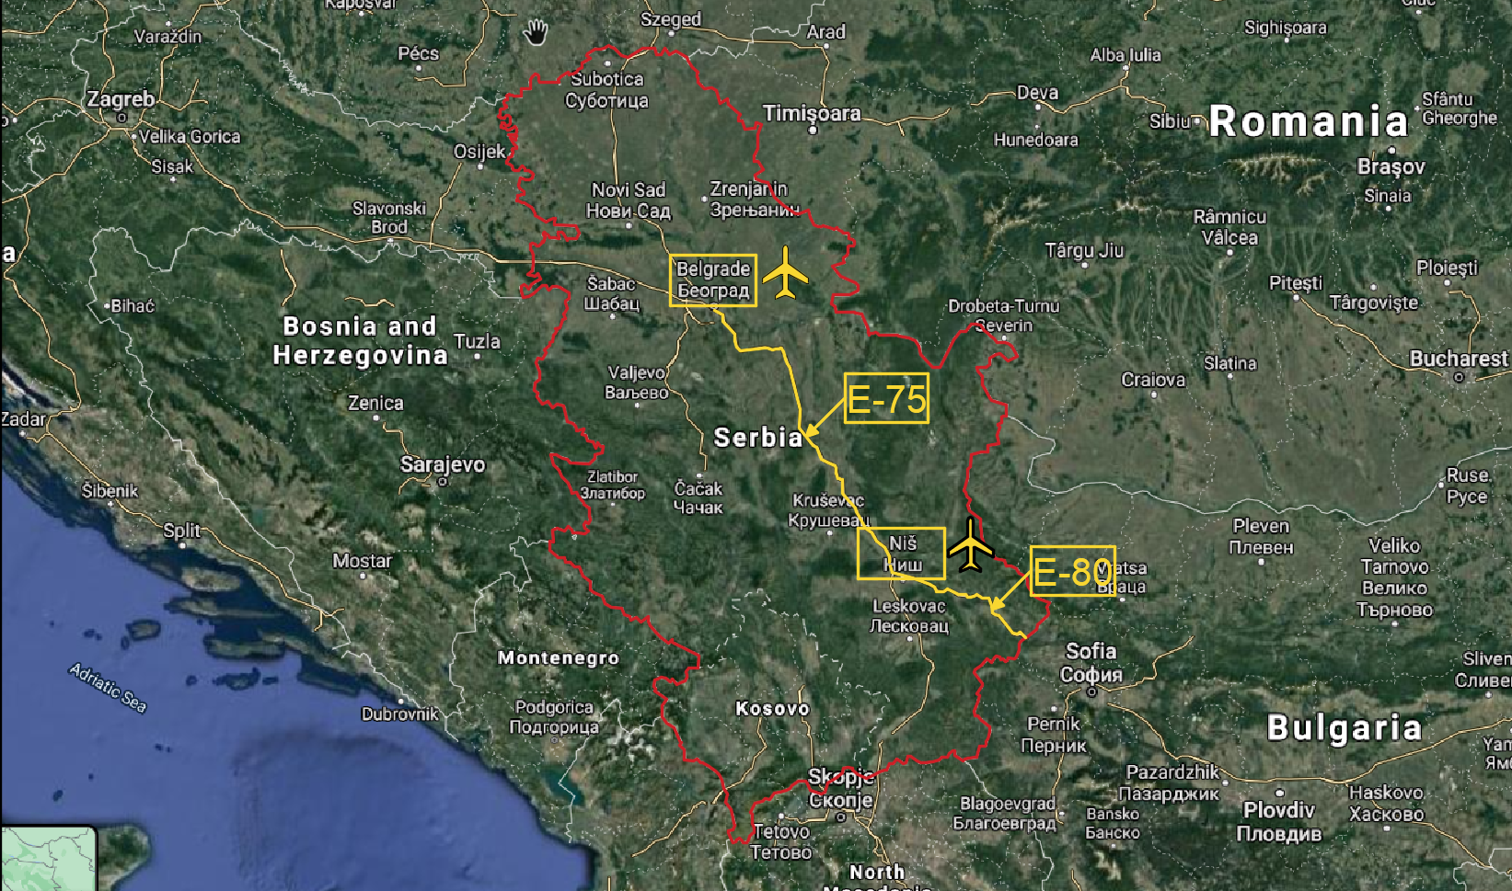
REPUBLIC OF SERBIA MINISTRY OF MINING AND ENERGY PE SRBIJAGAS MINISTRY OF FINANCE Department for Contracting and Financing of EU Funded Programmes
This project is funded by the European Union
PROJECT LOCATION
RUCTIONS TO TENDERERS, Section 1.2 TIMETABLE TENDERERS, Section 1.2 INSTRUCTIONS TO TENDERERS, Section 1.2 TIMETABLE TIMETABLE

Slide 10
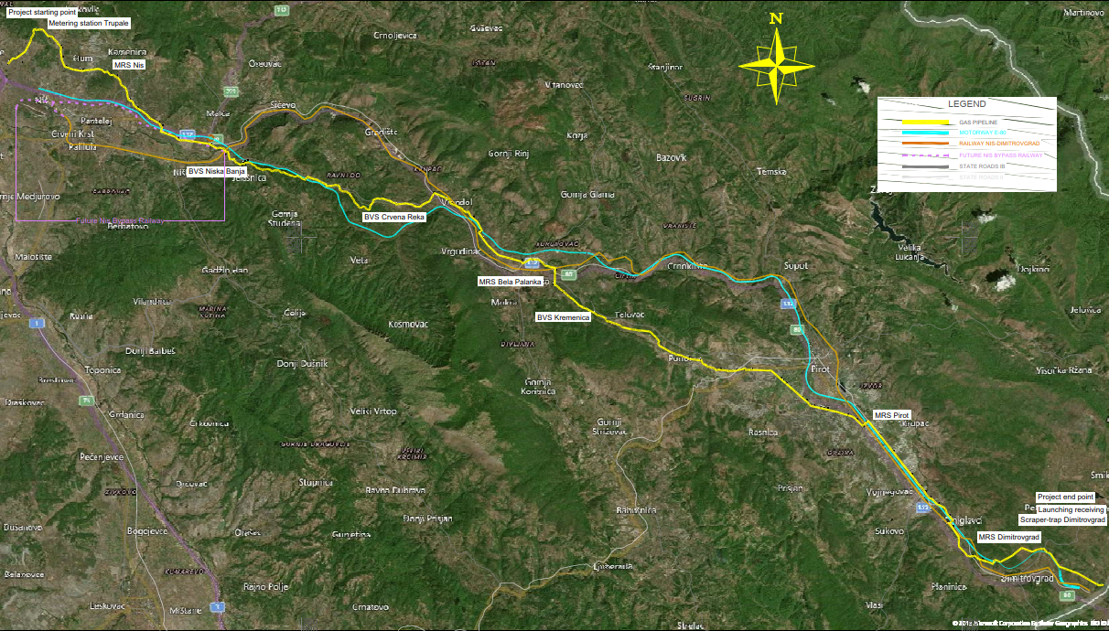
REPUBLIC OF SERBIA MINISTRY OF MINING AND ENERGY PE SRBIJAGAS MINISTRY OF FINANCE Department for Contracting and Financing of EU Funded Programmes
This project is funded by the European Union
PROJECT LOCATION
RUCTIONS TO TENDERERS, Section 1.2 TIMETABLE TENDERERS, Section 1.2 INSTRUCTIONS TO TENDERERS, Section 1.2 TIMETABLE TIMETABLE

Slide 11
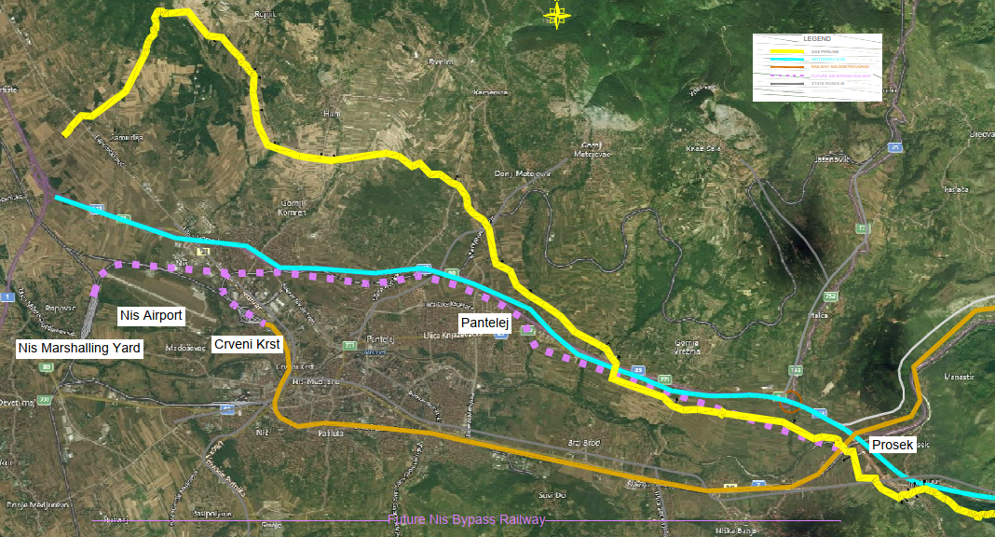
REPUBLIC OF SERBIA MINISTRY OF MINING AND ENERGY PE SRBIJAGAS MINISTRY OF FINANCE Department for Contracting and Financing of EU Funded Programmes
This project is funded by the European Union
PROJECT LOCATION
RUCTIONS TO TENDERERS, Section 1.2 TIMETABLE TENDERERS, Section 1.2 INSTRUCTIONS TO TENDERERS, Section 1.2 TIMETABLE TIMETABLE

Slide 12
REPUBLIC OF SERBIA MINISTRY OF MINING AND ENERGY PE SRBIJAGAS MINISTRY OF FINANCE Department for Contracting and Financing of EU Funded Programmes
This project is funded by the European Union
GENERAL TECHNICAL NOTES
Two-way main gas pipeline MG10 Niš – Dimitrovgrad
Interconnection of gas transmission systems of the Republic of Serbia and the Republic Bulgaria
Main characteristics of gas pipeline:
total length: 109 km,
nominal diameter: DN700 and
maximum operating pressure: MOP=55 bar.
Four gas metering and regulating stations:
MRS “Niš 2”,
MRS “Bela Palanka”,
MRS “Pirot” and
MRS “Dimitrovgrad”.
Table of crossings
Type |  | Number
Road |  | 51
Railway | Existing | 7
 | Newly Designed | 3
River | Mayor | 5
 | Minor | 25

Slide 13
REPUBLIC OF SERBIA MINISTRY OF MINING AND ENERGY PE SRBIJAGAS MINISTRY OF FINANCE Department for Contracting and Financing of EU Funded Programmes
This project is funded by the European Union
Thank you for your attention

