Slide 1


Construction of municipal wastewater collection and treatment system in Čačak
Tender Ref. No. NEAR/BEG/2023/EA-OP/0148
Site Visit and Clarification Meeting
17 January 2024
Government of the Republic of Serbia
Ministry of Environmental Protection
Ministry of Finance,
Department for Contracting and Financing of
EU Funded Programmes

Slide 2
The Works
Part 1: Design and construction of WWTP Prelići with construction of the access road to the WWTP
Part 2: Rehabilitation of sewage pumping stations PS Ljubić Polje, PS Beljina and PS Košutnjak with construction of the access road to the pumping station PS Ljubić Polje
Part 3: Cleaning, CCTV inspection, design and rehabilitation of sewers
Part 4: Supply of sewer cleaning and investigation equipment

Slide 3
Location of
The Works
Čačak WWTP

Slide 4
Part 1: Design and construction of WWTP Prelići with construction of the access road to the WWTP
Location of the WWTP
1 km east of the town
Bordered by three water courses:
  Atenica River in the West
  Zapadna Morava River in the North
  Trnava River in the East
Cadastral plots 138, 139, 140/1, 140/2, 140/3, 141, 142/1, 142/2, 142/3, 148/1, 148/2 in Atenica
Total area ~ 5,4 ha
Čačak WWTP

Slide 5
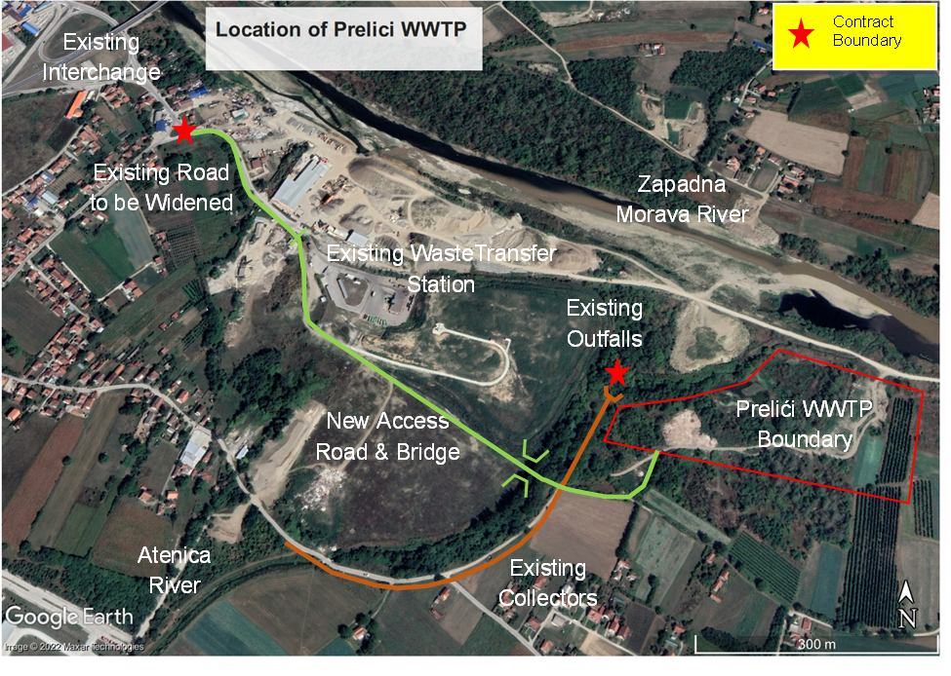
Part 1: Design and construction of WWTP Prelići with construction of the access road to the WWTP
Contract Interfaces
Access road – app. 200 m to the Southeast of onterchange with southern by-pass around Čačak;
New Transformer Station 10/0.4 kV (10 kV cable connection to be installed by Electromreže Čačak);
Water meter at entrance of the WWTP to be installed by PUC;
SCADA – WAN of PUC via internet;
Telephone and Internet connection;
Diversion manhole to divert wastewater from the existing sewer mains DN1200 to the WWTP
Flood protection and treated effluent discharge into the Zapadna Morava river
Čačak WWTP

Slide 6

Collection Manhole, CSO and
Diversion Manhole
Loznica WWTP
Čačak WWTP

Slide 7
Basic Design Criteria
Wastewater Flows | Phase 1 | Phase 2
Average daily dry weather flow Q_{DWF}, m³/d | 22,378 | 26,784
Average daily dry weather flow Q_{DWF}, l/s | 259 | 310
Maximum dry weather flow, Q_{MDWF}, l/s | 431 | 566
Peak flow Q_{WWF1}, l/s | 828 | 1,013
Storm flow Q_{WWF2}, l/s | 1,428 | 1,613
WWTP Loads | Phase 1 | Phase 2
Population equivalent | 96,000 | 128,000
Loznica WWTP
Required Effluent Quality | Phase 1 | Phase 2
BOD₅ | 25 | 25
COD | 125 | 125
TSS | 35 | 35
TN | 15 | 10
TP | 2 | 1
Effluent disinfection | Y | Y
Čačak WWTP

Slide 8
Part 1: Scope of Works
1
Design
- Conceptual design of the WWTP (Phase I and Phase II) for obtaining Location Conditions
- Preliminary design of the WWTP to be constructed under this Contract (Phase I)
-EIA update (if necessary)
- Design for Construction Permit
- Design for Construction
- As built design
2
Construction
- WWTP (construction, testing and commissioning, trial operation)
- Access road (based on Employer’s design)
- Flood protection – construction of the embankment along the Atenica river (Q1%) and effluent discharge
3
Tests on Completion and Taking Over
- Pre-commissioning tests
- Commissioning tests
- Trial operation
4
Assisted Operation and Training during DNP (90 days)
- Tests after completion
- Performance Guarantee Tests
- DNP 365 days

Slide 9
Part 2: Rehabilitation of sewage pumping stations PS Ljubić Polje, PS Beljina and PS Košutnjak with construction of the access road to the pumping station PS Ljubić Polje
(based on Employer’s design)
Contract Interfaces
Municipal roads;
Electricity provider’s meter in the 0.4kV distribution board (to be moved as necessary);
Wastewater collection system;
Connection of new pressure pipe from Beljina SPS;
SCADA – WAN of PUC via internet.
Čačak WWTP

Slide 10
SPS Ljubić Polje
SPS Ljubić Polje | Unit | Value
Q (duty) | l/s | 350
Head | m | Contractor to design
Čačak WWTP

Slide 11
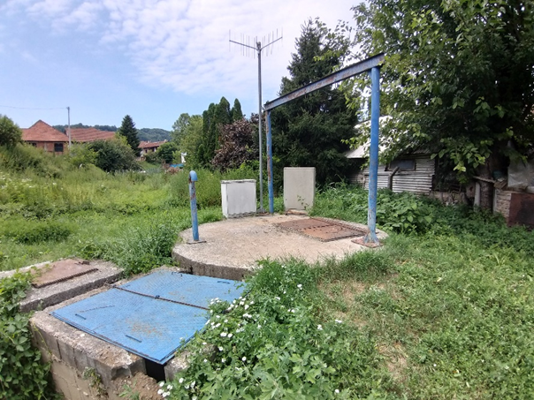
SPS Beljina
SPS Beljina | Unit | Value
Q (duty) | l/s | 25
Head | m | Contractor to design
Čačak WWTP

Slide 12
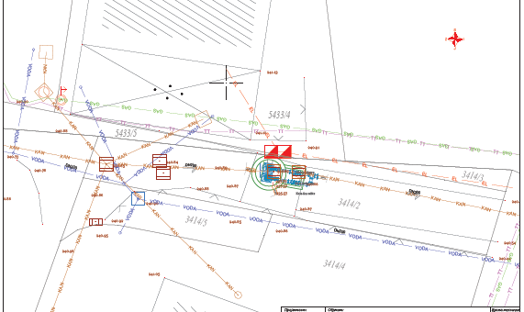
SPS Košutnjak
SPS Košutnjak | Unit | Value
Q (duty) | l/s | 32
Head | m | Contractor to design
Čačak WWTP

Slide 13
Part 2: Scope of Works
1
Design
- Conceptual and Preliminary designs for SPS Beljina only
- Designs for Construction for all SPSs
- As built design for all SPSs
2
Construction
- SPS Ljubić Polje with access road (based on Employer’s design)
- SPS Beljina (based on Contractor’s design)
- SPS Košutnjak (based on Employer’s design)
3
Tests on Completion and Taking Over
- Pre-commissioning tests
- Commissioning tests
4
DNP
- DNP 365 days

Slide 14
Part 3: Cleaning, CCTV inspection, design and rehabilitation of sewers (based on Employer’s design)
No. | Street | Depth m | Material
1 | Heroja Đurakića | 3.0-4.0 | Ceramic
2 | Hajduk Veljkova | 4.5-5.0 | Concrete
3 | Veselina Milekica F.Filipovica | 4.5-5.0 | Ceramic
4 | Vojvode Stepe | 4.5-5.0 | Concrete
Čačak WWTP

Slide 15
Time for Completion(based on Employer’s design)
Activity | Duration
Part 1: Preparation of designs for the construction of the WWTP Prelići (update/adjustments of Employer’s designs, obtaining updated Location Conditions and approval on adjusted Preliminary Design, Design for Construction Permit, Design for Construction) | 365 days from the Commencement Date
Part 3: Completion of CCTV investigations in preparation for sewer rehabilitation | 180 days from the Commencement Date
Part 4: Supply of Sewer Cleaning and Investigation Equipment | 180 days from the Commencement Date
Conceptual design, preliminary design and other design for rehabilitation of sewers | 365 days from the Commencement Date
Time for Completion | 1095 days from the Commencement Date
Defects Notification Period | 365 calendar days from Issue of Taking-Over Certificate
Assisted operation during DNP | 90 days from Issue of Taking-Over Certificate
Čačak WWTP

Slide 16
Questions

Slide 17
Thank you
Government of the Republic of Serbia
Ministry of Environmental Protection
Ministry of Finance,
Department for Contracting and Financing of
EU Funded Programmes

